Slide 1


Slide 2

October 2016 General Conference
Questions Asked
Lists Given
Doctrinal Mastery
Apostles And Prophets
Stories Told
Grab Bag
100 | 100 | 100 | 100 | 100 | 100
200 | 200 | 200 | 200 | 200 | 200
300 | 300 | 300 | 300 | 300 | 300
400 | 400 | 400 | 400 | 400 | 400
500 | 500 | 500 | 500 | 500 | 500
Final Jeopardy

Slide 3
Questions Answered 100
Elder J. Devn Cornish said, “The answers to the questions “Am I good enough?” and “Will I make it?” are,”
What was the answer?

Slide 4
Questions Answered 100
YES!
“Yes! You are going to be good enough” and “Yes, you are going to make it as long as you keep repenting and do not rationalize or rebel.”
Click Star

Slide 5
Questions Answered 200
President Thomas S. Monson spoke about being
at the World’s Fair in 1965. At the Mormon Pavilion was shown the film Man’s Search For Happiness. The narrator of the film started by asking three poignant and universal questions.
Name one of them.

Slide 6
Questions Answered 200
Where did I come from?
Why am I here?
Where do I go when I leave this life?
Click Star

Slide 7
Questions Answered 300
Elder M. Russell Ballard said, "One of the most heart-wrenching stories in scripture occurred when 'many of [the Lord's] disciples' found it hard to accept His teachings and doctrine, and they 'went back, and walked no more with him,’ (See John 6:66.)
"As these disciples left, Jesus turned to the Twelve and asked, 'Will ye also go away?’”
How did Peter answer the question?

Slide 8
Questions Answered 300
'Lord, to whom shall we go?
Click Star

Slide 9
Questions Answered 400
President Uchtdorf invited members to consider the question he recently noticed on the Belfast Coat of Arms —
“Pro tanto quid retribuamus”
What was the question in English?

Slide 10
Questions Answered 400
“What shall we give in return for so much?”
Click Star

Slide 11
Questions Answered 500
Elder Robert D. Hales said, “Nobel laureate Elie Wiesel was in the hospital recovering from open-heart surgery when he was visited by his five-year-old grandson. As the little boy looked into his grandfather’s eyes, he saw his pain. “Grandpa,” he asked, “if I loved you more, would you hurt less?” Today I ask a similar question of each of us:”
What was the question?

Slide 12
Questions Answered 500
“If we love the Savior more, will we suffer less?”
Click Star

Slide 13
Lists Given 100
Elder Dallin H. Oaks said, “There are three things all members can do to help share the gospel, regardless of the circumstances in which they live and work. All of us should do all of these.
Name two of those things.

Slide 14
Lists Given 100
1. We can all pray for desire to help with this vital part of the work of salvation.
2. We can keep the commandments ourselves.
3. We can pray for inspiration on what we can do in our individual circumstances to share the gospel with others.
Click Star

Slide 15
Lists Given 200
Elder W. Mark Bassett used Nephi as an example of someone who sought knowledge. He listed seven things Nephi did. Name 4 of them.

Slide 16
Lists Given 200
a sincere desire,
humility,
prayer,
trust in the prophet,
an exercise of faith,
diligence,
obedience.
Click Star

Slide 17
Lists Given 300
Elder David A. Bednar taught, “A grand objective of mortality is not merely learning about the Only Begotten of the Father but also striving to know Him. Four essential steps that can help us come to know the Lord are:”
Name two essential steps.

Slide 18
Lists Given 300
Exercising faith in Him
Following Him
Serving Him
Believing Him.
Click Star

Slide 19
Lists Given 400
Elder Quentin L. Cook identified three common stumbling blocks that can “confuse and complicate” one's pure and simple testimony of the Father and the Son.
Name one stumbling block.

Slide 20
Lists Given 400
The philosophies of men
Refusing to see sin in its true light
Looking beyond the mark
Click Star

Slide 21
Lists Given 500
Elder Peter F. Meurs invited all of us to consider five ways to increase the impact and power of our regular participation in the sacred ordinance of the sacrament. Name three of those ways.

Slide 22
Lists Given 500
Prepare in Advance
Arrive Early
Sing and Learn from the Words of the Sacrament Hymn
Spiritually Participate in the Sacrament Prayers
Ponder and Remember Christ as the Sacrament Emblems Are Passed
Click Star

Slide 23
Doctrinal Mastery 100
Both President Uchtdorf and President Monson gave talks about this doctrinal mastery topic.

Slide 24
Doctrinal Mastery 100
The Plan of Salvation
Click Star

Slide 25
Doctrinal Mastery 200
Elder David A. Bednar taught it is important to come to know the Lord. Two Doctrinal Mastery scriptures teach the same thing: “eternal life is to know God” and “if we do His will, we will know His doctrine”
Find one of the two scriptures!

Slide 26
Doctrinal Mastery 200
John 17:3 or John 7:17
Click Star

Slide 27
Doctrinal Mastery 300
Both Elder Robert D. Hales and Elder David A. Bednar quoted the scripture “If ye love me, keep my commandments”.
Find the scripture!

Slide 28
Doctrinal Mastery 300
John 14:15
Click Star

Slide 29
Double
Jeopardy!!

Slide 30
Doctrinal Mastery 400
Elder Quentin L. Cook quoted this doctrinal mastery scripture:
“For as in Adam all die, even so in Christ shall all be made alive.”
Find that scripture!

Slide 31
Doctrinal Mastery 400
1 Corinthians 15: 22
Click Star

Slide 32
Doctrinal Mastery 500
President Thomas S. Monson quoted this doctrinal mastery scripture:
“This is my work and my glory—to bring to pass the immortality and eternal life of man.”
Find the scripture!

Slide 33
Doctrinal Mastery 500
Moses 1:39
Click Star

Slide 34
Apostles & Prophets 100
Which apostle told how he and a friend set off a fire cracker at church?

Slide 35
Apostles & Prophets 100
Elder Dale G. Renlund
Click Star

Slide 36
Apostles & Prophets 200
This apostle was named to honor his ancestors including early Mormon pioneers who joined the Church in Denmark.

Slide 37
Apostles & Prophets 200
Elder Ronald A. Rasband
Click Star

Slide 38
Apostles & Prophets 300
Which apostle used puzzle pieces to teach about the gathering of Israel that will occur before the Lord’s second coming?

Slide 39
Apostles & Prophets 300
Elder Neil L. Andersen
Click Star

Slide 40
Apostles & Prophets 400
Which apostle shared the story of Helen Keller?

Slide 41
Apostles & Prophets 400
Elder D. Todd Christofferson
Click Star

Slide 42
Apostles & Prophets 500
Which apostle spoke about gratitude on the Sabbath?

Slide 43
Apostles & Prophets 500
President Henry B. Eyring
Click Star

Slide 44
Stories Told 100
Elder Juan A. Uceda told an experience he had while serving a mission in Cusco, Peru, in 1977. What happened to him?

Slide 45
Stories Told 100
Elder Uceda and several fellow missionaries visited the famous Machu Picchu ruins. After visiting the ruins, some of the missionaries wanted to walk a treacherous trail to visit the Inka Bridge. A strong spiritual prompting warned Elder Uceda that he and the others should not traverse the trail, but he gave in to peer pressure and continued.
Soon the lofty trail narrowed. At one point, Elder Uceda found a missionary standing with his back against the rock. The missionary said he had received an impression to remain in that spot.
“I felt the urgency to catch up to those ahead of us, so he helped me to pass him, and I was able to get a little further down the trail,” he said. “I noticed that the ground was full of greenery. I planted my right foot on the ground realizing, as I fell, that there was no ground underneath the greenery. I desperately grabbed onto some branches that were underneath the trail. For a moment I could see down, some 2,000 feet below.”
Elder Uceda knew he could not hold to the branches for long. He opened his mouth and uttered a brief, desperate prayer: “Father, help me!”
Just as he was about to fall, he felt a firm hand take his arm and pull him up to safety. The hand belonged to the missionary who had felt prompted to stay behind.
“But in reality, our Father in Heaven saved me,” he said. “He listened to my voice.”
Click Star

Slide 46
Stories Told 200
Elder W. Mark Bassett shared a story of what he and his brother tried to do with a gift that was given to their parents. Tell the story.

Slide 47
Stories Told 200
Elder Bassett told of a miniature model of the golden plates his parents had displayed in their home. Familiar with the stories of the Restoration, Elder Bassett — along with his brother — wondered what was written on the small section that was securely sealed. The curious boys tried, on several occasions, to pry open the sealed portion of the model plates.
Click Star

Slide 48
Stories Told 300
Elder Gary E. Stevenson shared the story of Mary Elizabeth Rollins to show the rising generation "how to get closer to the Lord and access greater power to resist temptation.”
What did Mary do?

Slide 49
Stories Told 300
Read the Book of Mormon
After pleading with Isaac Morely to borrow the Book of Mormon, he relented, allowing Mary to take it home and read it for the night. She ran home and stayed up nearly the whole night reading it. Impressed by how much she had read and learned in such a short time, Brother Morely allowed her to keep it until she finished.
A short time later Mary finished reading the book and was the first person in her town to read the entire book. She knew it was true and that it came from Heavenly Father.
Click Star

Slide 50
Stories Told 400
Elder K. Brett Nattress shared how during a family scripture study one morning when he was young he told his mother, "Mom, I am not listening!"
"Her loving response was a defining moment in my life. She said, 'Son, I was at a meeting where President Marion G. Romney taught about the blessings of scripture reading. During this meeting, I received a promise that if I would read the Book of Mormon to my children every day, I would not lose them.' She then looked me straight in the eyes and, with absolute determination, said,”
What did his mother say?

Slide 51
Stories Told 400
'And I will not lose you!'
Click Star

Slide 52
Stories Told 500
Elder Kazuhiko Yamashita told the following story, “In 1876, a renowned educator named Dr. William Clark was invited to come to Hokkaido to teach. He lived in Japan for just eight months, but his Christian spirit left a lasting impression on his young non-Christian students. Before leaving, he gave his students a parting message that has become immortalized.”
What did Dr. Clark say?

Slide 53
Stories Told 500
“Boys, be ambitious!”—
“Be ambitious for Christ.”
Click Star

Slide 54
Grab Bag 100
Who sang in the Saturday afternoon session of conference?

Slide 55
Grab Bag 100
Missionaries from the MTC
Click Star

Slide 56
Double
Jeopardy!!

Slide 57
Grab Bag 200
Sister Linda S. Reeves spoke about the second principle of the gospel. What was her talk about?

Slide 58
Grab Bag 200
Repentance
Click Star

Slide 59
Grab Bag 300
Who said, “Joy is powerful, and focusing on joy brings God’s power.”?

Slide 60
Grab Bag 300
President Russell M. Nelson
Click Star

Slide 61
Grab Bag 400
Elder Craig C. Christensen said that many people receive a witness about the ___________________ by reading the Book of Mormon.
Fill in the blank.

Slide 62
Grab Bag 400
Prophet Joseph Smith
Click Star

Slide 63
Grab Bag 500
Sister Carol F. McConkie taught, “We pray to our Father in the name of Jesus Christ by the power of the Holy Ghost, thus engaging ______.”
Fill in the blank.

Slide 64
Grab Bag 500
All three members of the Godhead.
Click Star

Slide 65
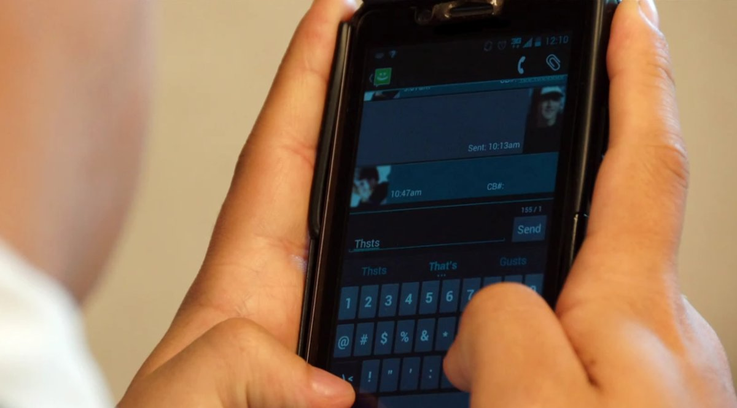
FINAL JEOPARDY
Elder Dallin H. Oaks said, “Describing the Savior’s visit to the Nephites Mormon writes, “He did teach and minister unto the children . . . and he loosed their tongues that they could utter.” Today I suppose we would say ________.”
Fill in the blank.

Slide 66
FINAL JEOPARDY
Loose their thumbs!
Click Star

